Slide 1

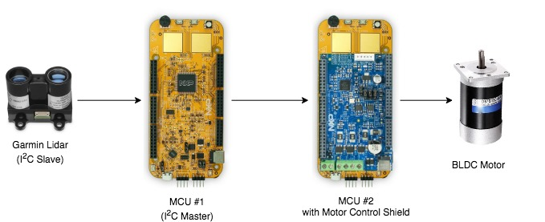
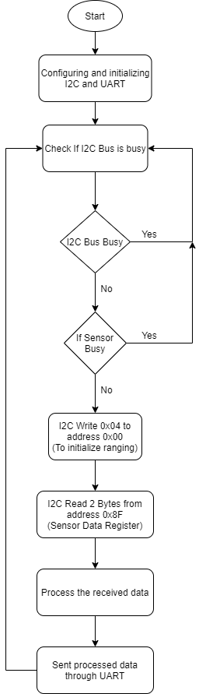
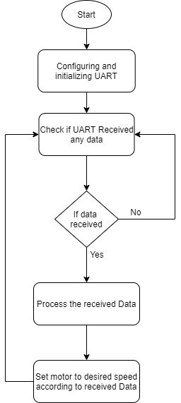
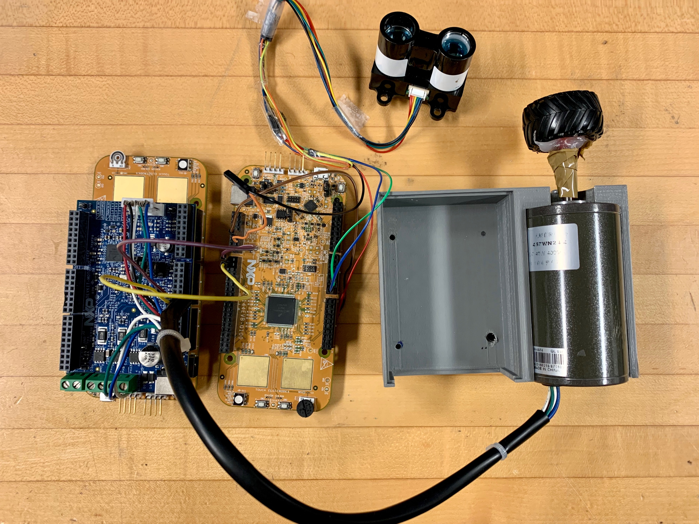
Adaptive Cruise Control Using LIDAR
Priyank Kalgaonkar, Arjun N A, Kavyashree Prasad S P
Introduction
System Architecture
Conclusions
As per the National Highway Transportation Safety Administration (NHTSA), about 29 percent of all car crashes are rear-end collisions in the USA that roughly estimates to 1.7 million rear-end collisions. Of these nearly 2 million accidents, about 1,700 people die and another 500,000 are injured in these types of road vehicle accidents.
The main objective of Adaptive Cruise Control Using LIDAR project is to enable the traditional cruise control system used in road vehicles to automatically slow down or speed up the vehicle up to a speed limit set by the driver. Our design of Automatic Cruise Control (ACC) system utilizes a LIDAR sensor that communicates with the on-board ECU (MCU for our project) using I²C protocol to enable this feature. The ACC system will control the speed of the vehicle the same way a driver does – by adjusting the throttle (accelerator) position. I²C Master (MCU #1) will receive data from I²C Slave (LIDAR sensor) which will then be transferred to MCU #2 via UART. MCU #2 will then utilize this information to control the BLDC motor which will simulate the ECU controlling the speed of the road vehicle.
Our prototype of Adaptive Cruise Control Using LIDAR utilizes hardware and multiple-access protocol such as I²C and UART to control the speed of the BLDC motor in real-time with minimal delay. The result is improved driver's comfort, and safety of the vehicle and other traffic on the road by minimizing rear-end collisions.
For future work, we recommend using CAN communication protocol combining our system with cameras, multiple sensors and computer vision processing to pave way for this system into the autonomous world of trucks and automobiles.
Software Flow Diagram for MCU 1 & 2
Working Prototype

